Slide 1
Tutorial 1
Non-linear equations

Slide 2
Taylor series
For a function f (x) it is known that f (1.8) = -1.1664 and f’(1.8) =3.8880. Find the approximate value of x when f (x) = 0, using Taylor series expansion.

Slide 3

Solution:
f(x) = f(a) + (x-a)f’(a) + $\frac{{(x−a)}^{2} f’’(a)}{2!}$..... + $\frac{{(x−a)}^{n} f^{n}(a)}{n!}$
(Expansion of Taylor series)
f(x) = f(1.8) + (x-1.8) f’(1.8) = 0 (Plug in numbers)
-1.1664 + 3.8880(x-1.8) = 0
x = 2.1

Slide 4

Root Finding Method: Fixed point
Find the root of the equation with fixed point method:
$$x^{2}−x−1=0$$

Slide 5
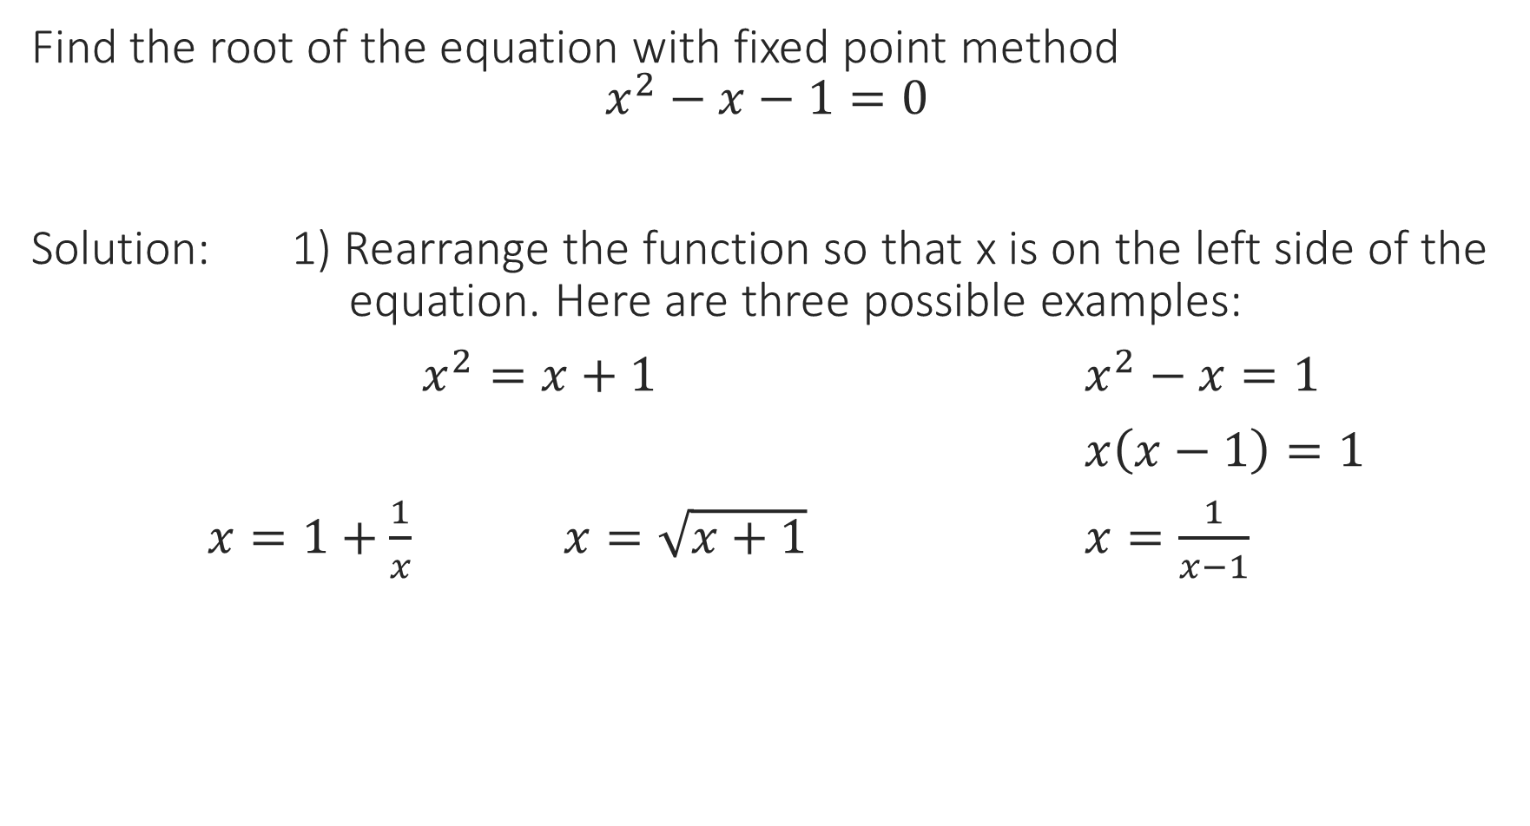
Find the root of the equation with fixed point method
$$x^{2}−x−1=0$$
Solution: 1) Rearrange the function so that x is on the left side of the equation. Here are three possible examples:
$x^{2}=x+1$ $x^{2}−x=1$
$x\left(x−1\right)=1$
$x=1+\frac{1}{x}$ $x=\sqrt{x+1}$ $x=\frac{1}{x−1}$
We could still use this but try to avoid it because of the square root (troubles identifying the solutions).

Slide 6
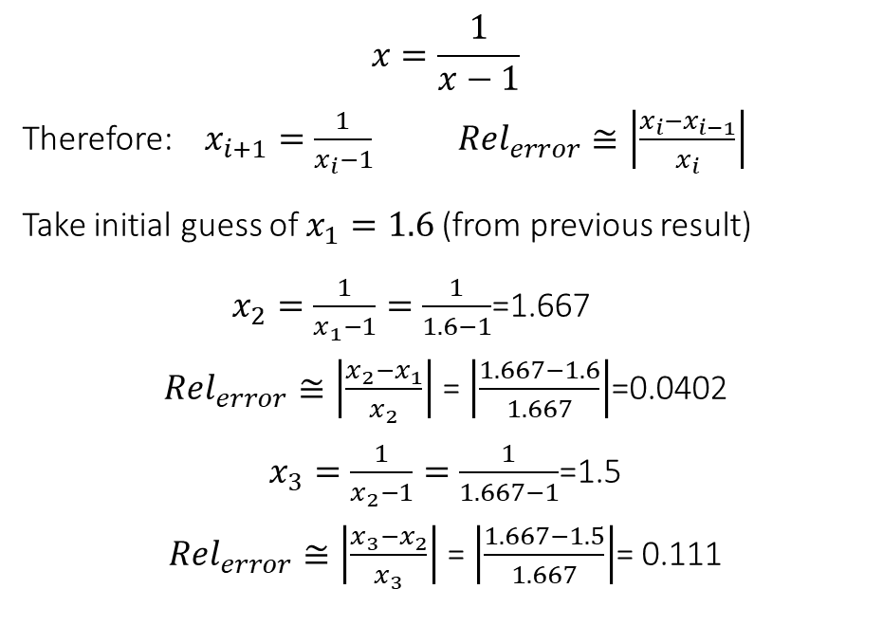
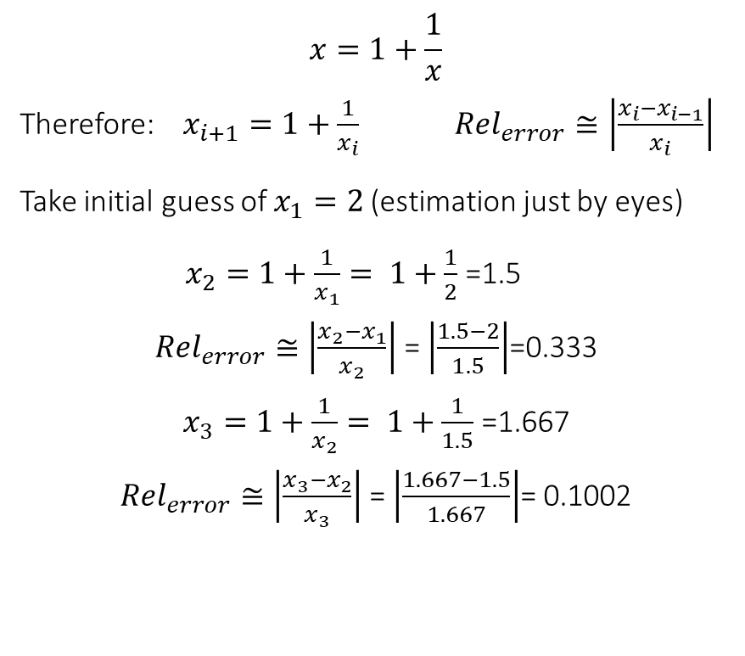
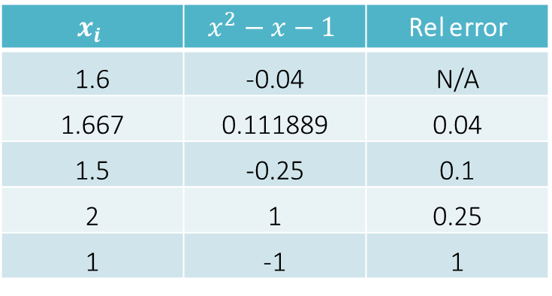
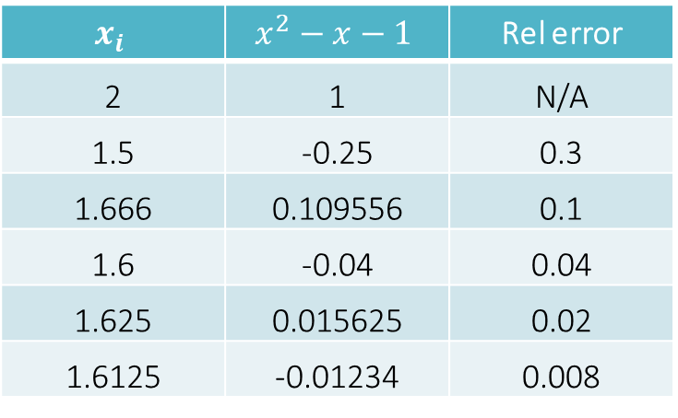
$$x=1+\frac{1}{x}$$
Therefore: $x_{i+1}=1+\frac{1}{x_{i}}$ ${Rel}_{error}≅\left|\frac{x_{i}−x_{i−1}}{x_{i}}\right|$
Take initial guess of $x_{1}=2$(estimation just by eyes)
$x_{2}=1+\frac{1}{x_{1}}= 1+\frac{1}{2}$ =1.5
${Rel}_{error}≅\left|\frac{x_{2}−x_{1}}{x_{2}}\right|$ = $\left|\frac{1.5−2}{1.5}\right|$=0.333
$x_{3}=1+\frac{1}{x_{2}}= 1+\frac{1}{1.5}$ =1.667
${Rel}_{error}≅\left|\frac{x_{3}−x_{2}}{x_{3}}\right|$ = $\left|\frac{1.667−1.5}{1.667}\right|$= 0.1002
$$x=\frac{1}{x−1}$$
Therefore: $x_{i+1}=\frac{1}{x_{i}−1}$ ${Rel}_{error}≅\left|\frac{x_{i}−x_{i−1}}{x_{i}}\right|$
Take initial guess of $x_{1}=1.6$(from previous result)
$x_{2}=\frac{1}{x_{1}−1}=\frac{1}{1.6−1}$=1.667
${Rel}_{error}≅\left|\frac{x_{2}−x_{1}}{x_{2}}\right|$ = $\left|\frac{1.667−1.6}{1.667}\right|$=0.0402
$x_{3}=\frac{1}{x_{2}−1}=\frac{1}{1.667−1}$=1.5
${Rel}_{error}≅\left|\frac{x_{3}−x_{2}}{x_{3}}\right|$ = $\left|\frac{1.667−1.5}{1.667}\right|$= 0.111
$$x_{i}$$ | $$x^{2}−x−1$$ | Rel error
2 | 1 | N/A
1.5 | -0.25 | 0.3
1.666 | 0.109556 | 0.1
1.6 | -0.04 | 0.04
1.625 | 0.015625 | 0.02
1.6125 | -0.01234 | 0.008
$$x_{i}$$ | $$x^{2}−x−1$$ | Rel error
1.6 | -0.04 | N/A
1.667 | 0.111889 | 0.04
1.5 | -0.25 | 0.1
2 | 1 | 0.25
1 | -1 | 1
Converging to 1.613
Root of the equation
Not converging

Slide 7
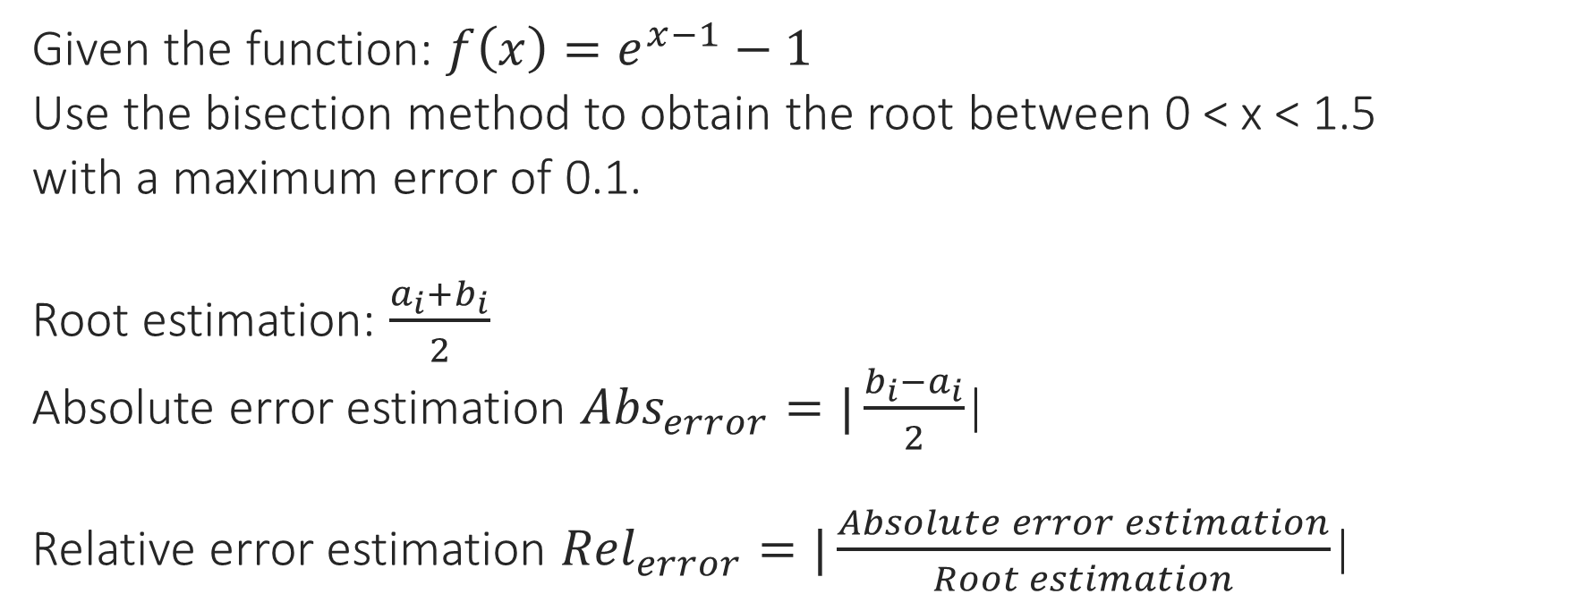
Root Finding Method: Bisection
Given the function: $f\left(x\right)=e^{x−1}−1$
Use the bisection method to obtain the root between 0 < x < 1.5
with a maximum error of 0.1.
Root estimation: $\frac{a_{i}+b_{i}}{2}$
Absolute error estimation ${Abs}_{error}=|\frac{b_{i}−a_{i}}{2}$|
Relative error estimation ${Rel}_{error}=|\frac{Absolute error estimation}{Root estimation}$|

Slide 8
Steps to solve problems:
The routine follows:
1) Determine the range.
2) Compute the mid‐point of the range.
3) Determine which of the old points is replaced with the mid‐point
4) Check for end condition (tolerance or error measure)
5) If met then end else repeat 1‐4.

Slide 9




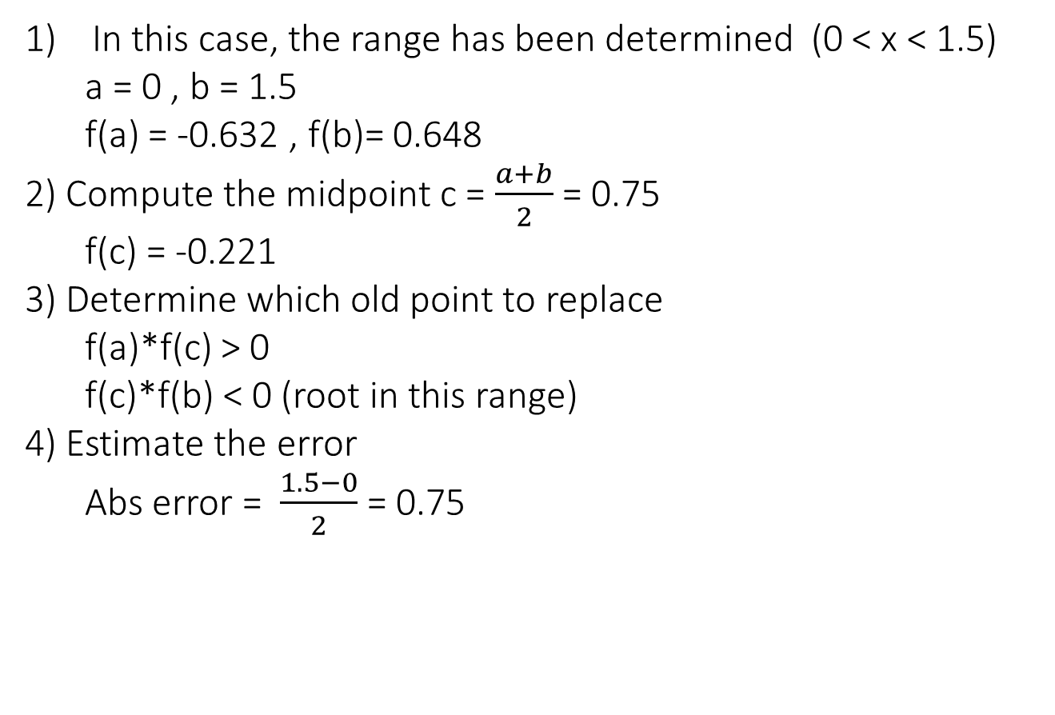






In this case, the range has been determined (0 < x < 1.5)
a = 0 , b = 1.5
f(a) = -0.632 , f(b)= 0.648
2) Compute the midpoint c = $\frac{a+b}{2}$ = 0.75
f(c) = -0.221
3) Determine which old point to replace
f(a)*f(c) > 0
f(c)*f(b) < 0 (root in this range)
4) Estimate the error
Abs error = $\frac{1.5−0}{2}$ = 0.75
$$y$$
$$y=f(x)$$
$$f(b)$$
$$a$$
$$c$$
$$r$$
$$b$$
$$x$$
$$f(c)$$
$$f(a)$$
i | a | b | c | f(a) | f(b) | f(c) | Abs error
1 | 0 | 1.5 | 0.75 | -0.632 | 0.648 | -0.221 | 0.8
2 | 0.75 | 1.5 | 1.125 | -0.221 | 0.648 | 0.1331 | 0.4
3 | 0.75 | 1.125 | 0.9375 | -0.221 | 0.1331 | -0.0605 | 0.2
4 | 0.9375 | 1.125 | 1.03125 | -0.0605 | 0.1331 | 0.031743 | 0.09

Slide 10
Notes:
With both of the bounds moving this approach will converge as long as the root begins within the range defined by the brackets.
Simple approach with well defined error makes for as quick to use this method.
Convergence by ½ the range at each iteration means that the number of terms required to get a high precision will be large, i.e. large number of iterations required.
Stable reliable method.

Slide 11

Extra Problem
Determine the smallest positive root between (0,2) of the given equation using Bisection method with an absolute error less than 0.02.
$f\left(x\right)= cos\left(x\right)− \frac{1}{x} ln⁡(x)$

Slide 12
Apply incremental search to narrow down the search range:
Because of the sign change of f(x), a root lies between 1 and 2
Therefore:
a = 1 , b = 2
f(a) = 0.540302, f(b)= -0.76272, f(c) = -0.19957
f(a)*f(c) < 0 (root in this range)
f(c)*f(b) > 0
x | 0 | 1 | 2
f(x) | +INF | 0.540302 | -0.76272
i | a | b | c | f(a) | f(b) | f(c) | Abs error
1 | 1 | 2 | 1.5 | 0.540302 | -0.76272 | -0.19957 | 0.5
2 | 1 | 1.5 | 1.25 | 0.540302 | -0.19957 | 0.136808 | 0.25
3 | 1.25 | 1.5 | 1.375 | 0.136808 | -0.19957 | -0.03706 | 0.125
4 | 1.25 | 1.375 | 1.3125 | 0.136808 | -0.03706 | 0.048246 | 0.0625
5 | 1.3125 | 1.375 | 1.34375 | 0.048246 | -0.03706 | 0.00522 | 0.03125
6 | 1.34375 | 1.375 | 1.359375 | 0.00522 | -0.03706 | -0.01601 | 0.015625
Root estimation with an absolute error less than 0.02 = 1.36 ± 0.02

Slide 13
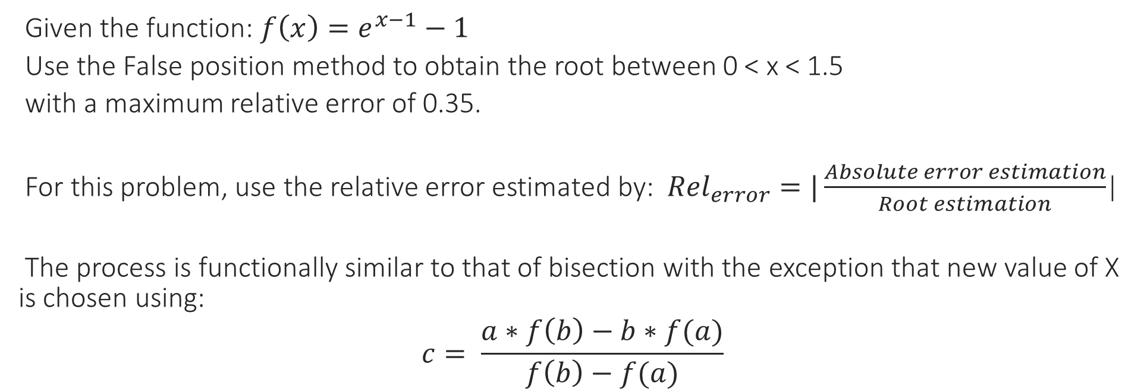
Root Finding Method: False Position Method.
Given the function: $f\left(x\right)=e^{x−1}−1$
Use the False position method to obtain the root between 0 < x < 1.5
with a maximum relative error of 0.35.
For this problem, use the relative error estimated by: ${Rel}_{error}=|\frac{Absolute error estimation}{Root estimation}$|
The process is functionally similar to that of bisection with the exception that new value of X is chosen using:
$$c= \frac{a∗f\left(b\right)−b∗f(a)}{f\left(b\right)−f(a)}$$

Slide 14
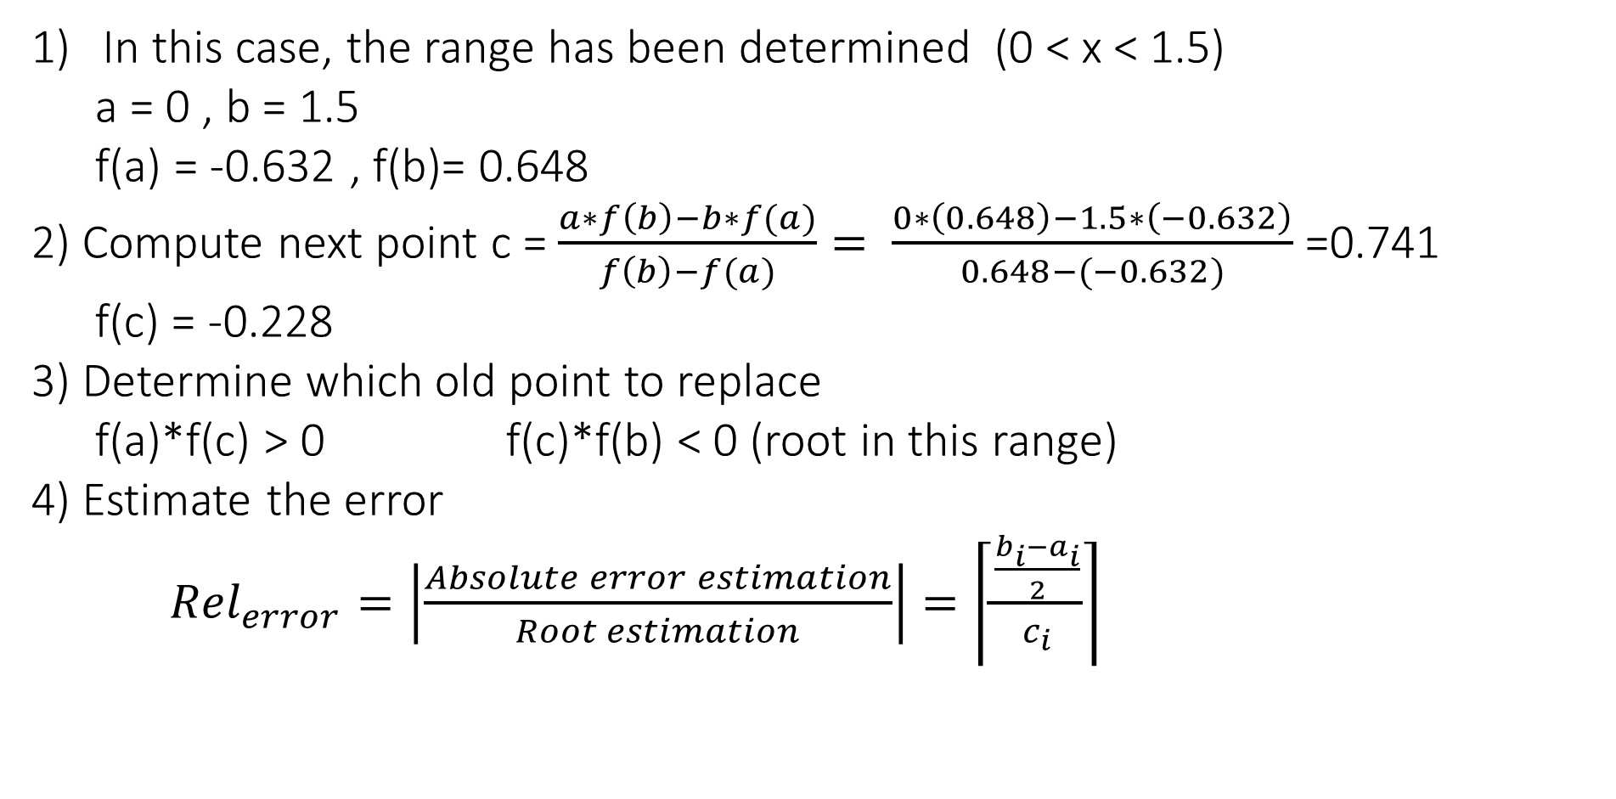
In this case, the range has been determined (0 < x < 1.5)
a = 0 , b = 1.5
f(a) = -0.632 , f(b)= 0.648
2) Compute next point c =$\frac{a∗f\left(b\right)−b∗f(a)}{f\left(b\right)−f(a)}= \frac{0∗\left(0.648\right)−1.5∗\left(−0.632\right)}{0.648−(−0.632)}$=0.741
f(c) = -0.228
3) Determine which old point to replace
f(a)*f(c) > 0 f(c)*f(b) < 0 (root in this range)
4) Estimate the error
${Rel}_{error}=\left|\frac{Absolute error estimation}{Root estimation}\right|=\left\lceil \frac{\frac{b_{i}−a_{i}}{2}}{c_{i}}\right\rceil$
i | a | b | c | f(a) | f(b) | f(c) | Rel error
0 | 0 | 1.5 | 0.741 | -0.632 | 0.648 | -0.228 | 1
1 | 0.741 | 1.5 | 0.937 | -0.228 | 0.648 | -0.06 | 0.4
2 | 0.937 | 1.5 | 0.938548 | -0.06106 | 0.648721 | -0.0596 | 0.3

Slide 15
Extra Problem
Determine the smallest positive root between (1,2) of the given equation using Regula Falsi with a relative error less than 0.14.

Slide 16
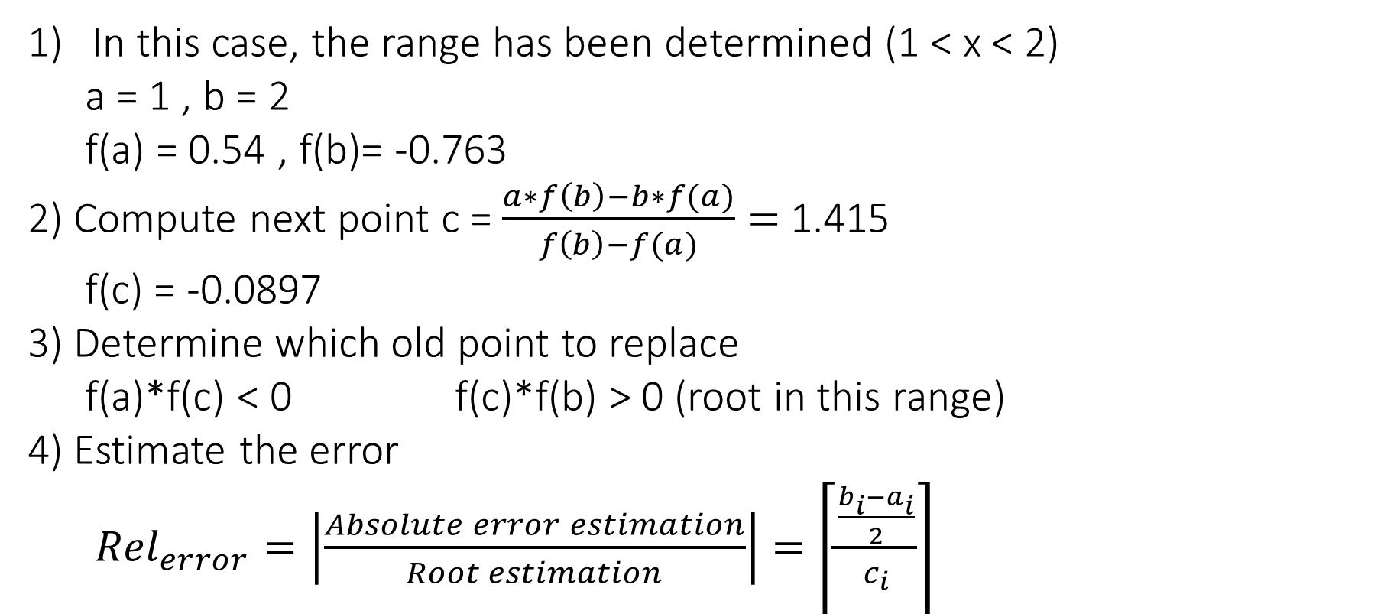
In this case, the range has been determined (1 < x < 2)
a = 1 , b = 2
f(a) = 0.54 , f(b)= -0.763
2) Compute next point c =$\frac{a∗f\left(b\right)−b∗f(a)}{f\left(b\right)−f(a)}=$1.415
f(c) = -0.0897
3) Determine which old point to replace
f(a)*f(c) < 0 f(c)*f(b) > 0 (root in this range)
4) Estimate the error
${Rel}_{error}=\left|\frac{Absolute error estimation}{Root estimation}\right|=\left\lceil \frac{\frac{b_{i}−a_{i}}{2}}{c_{i}}\right\rceil$
i | a | b | c | f(a) | f(b) | f(c) | Rel error
0 | 1 | 2 | 1.4147 | 0.5403 | -0.7627 | -0.0897 | 0.3534
1 | 1 | 1.4147 | 1.3556 | 0.5403 | -0.0897 | -0.0109 | 0.1529
2 | 1 | 1.3556 | 1.3486 | 0.5403 | -0.0109 | -0.0014 | 0.1318
Root estimation with a relative error less than 0.14: 1.35 ± 0.02

Slide 17
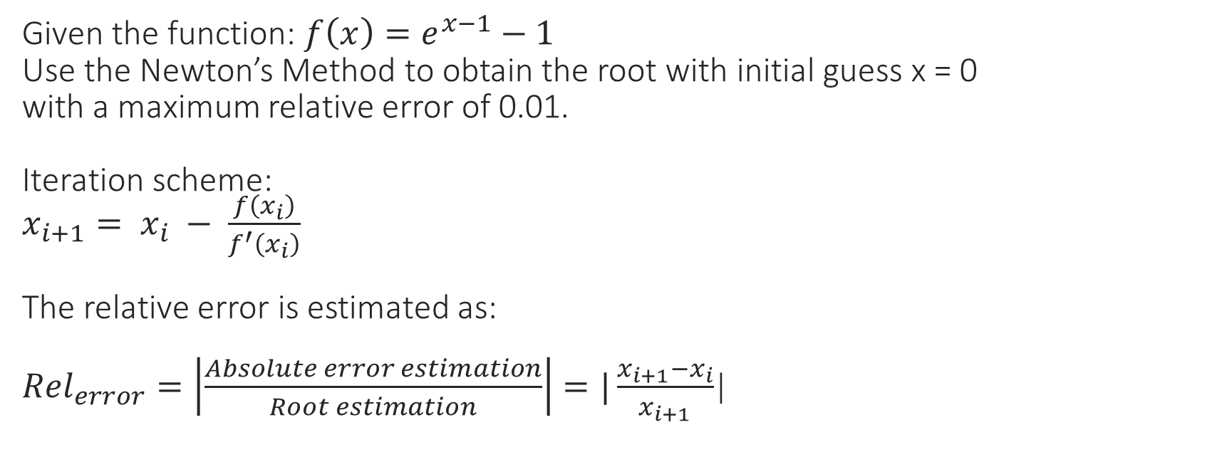
Root Finding Method: Newton’s Method.
Given the function: $f\left(x\right)=e^{x−1}−1$
Use the Newton’s Method to obtain the root with initial guess x = 0
with a maximum relative error of 0.01.
Iteration scheme:
$x_{i+1}= x_{i} − \frac{f\left(x_{i}\right)}{f^{′}\left(x_{i}\right)}$
The relative error is estimated as:
${Rel}_{error}=\left|\frac{Absolute error estimation}{Root estimation}\right|=|\frac{x_{i+1}−x_{i}}{x_{i+1}}$|

Slide 18
Steps to solve problems:
1) Give an initial guess for root (by plotting the function).
2) Use update relation to compute new estimate of root.
3) Check error for ending of process.
4) If error bound not met, repeat steps 2 and 3.

Slide 19
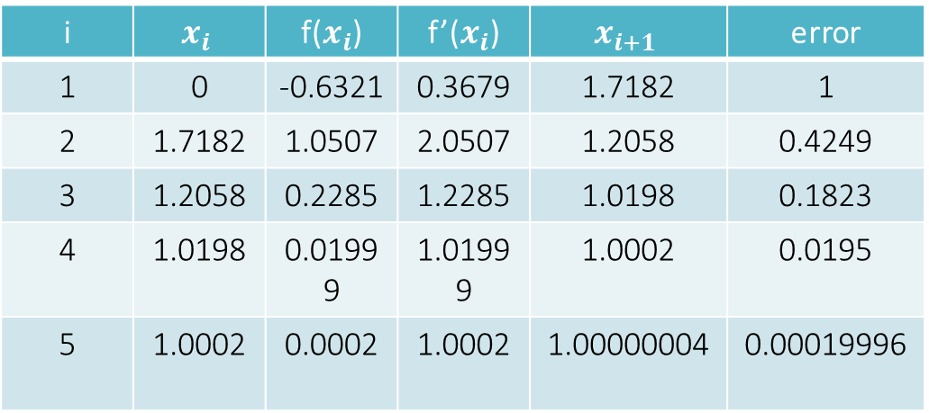
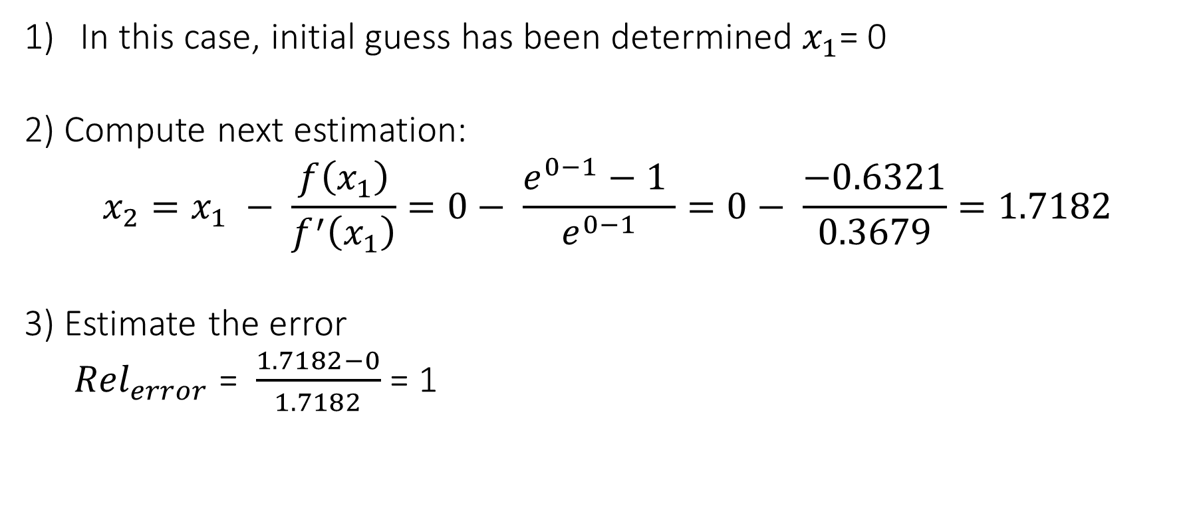
In this case, initial guess has been determined $x_{1}$= 0
2) Compute next estimation:
$$x_{2}=x_{1} − \frac{f\left(x_{1}\right)}{f^{′}\left(x_{1}\right)}=0− \frac{e^{0−1}−1 }{e^{0−1}}=0− \frac{−0.6321}{0.3679}=1.7182$$
3) Estimate the error
${Rel}_{error}$ = $\frac{1.7182−0}{1.7182}$ = 1
i | $$x_{i}$$ | f($x_{i}$) | f’($x_{i}$) | $$x_{i+1}$$ | error
1 | 0 | -0.6321 | 0.3679 | 1.7182 | 1
2 | 1.7182 | 1.0507 | 2.0507 | 1.2058 | 0.4249
3 | 1.2058 | 0.2285 | 1.2285 | 1.0198 | 0.1823
4 | 1.0198 | 0.01999 | 1.01999 | 1.0002 | 0.0195
5 | 1.0002 | 0.0002 | 1.0002 | 1.00000004 | 0.00019996

Slide 20
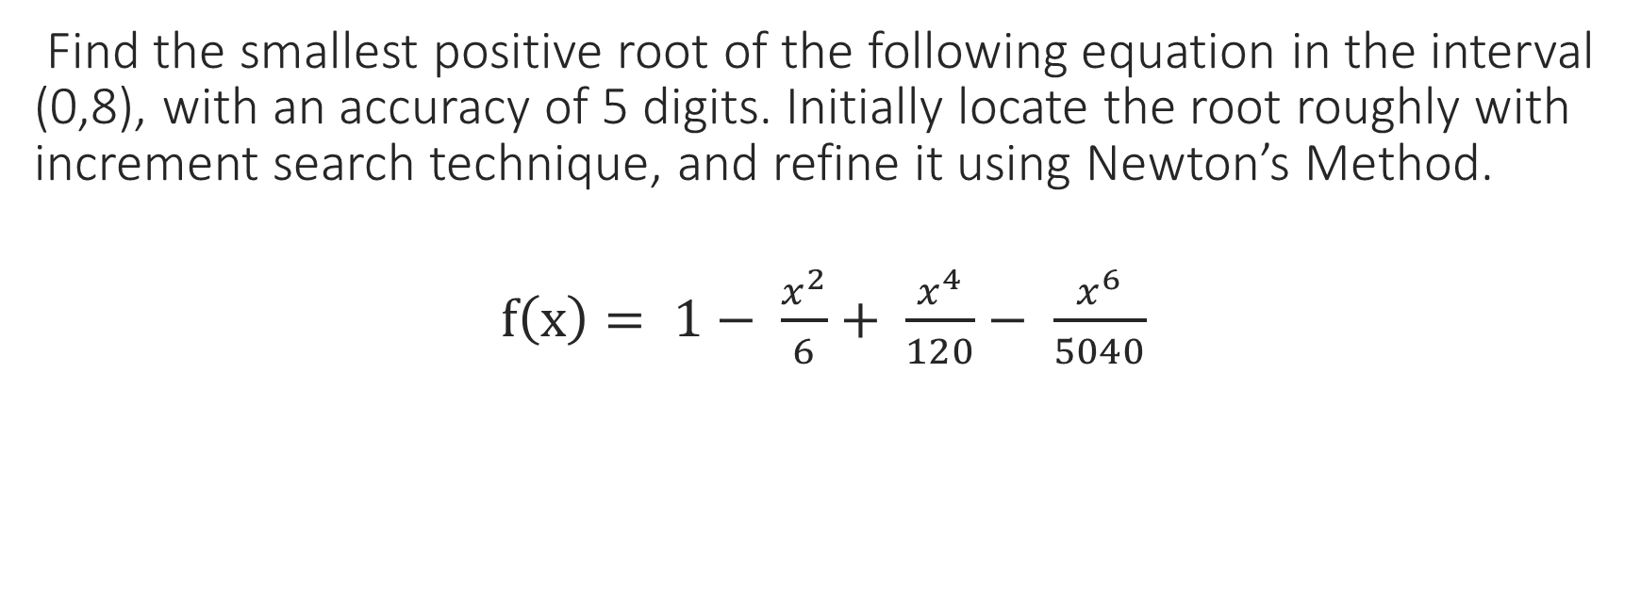
Extra Problem
Find the smallest positive root of the following equation in the interval (0,8), with an accuracy of 5 digits. Initially locate the root roughly with increment search technique, and refine it using Newton’s Method.
$f\left(x\right)= 1− \frac{x^{2}}{6}+ \frac{x^{4}}{120}− \frac{x^{6}}{5040}$

Slide 21
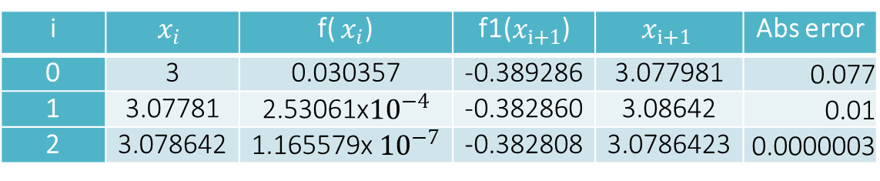
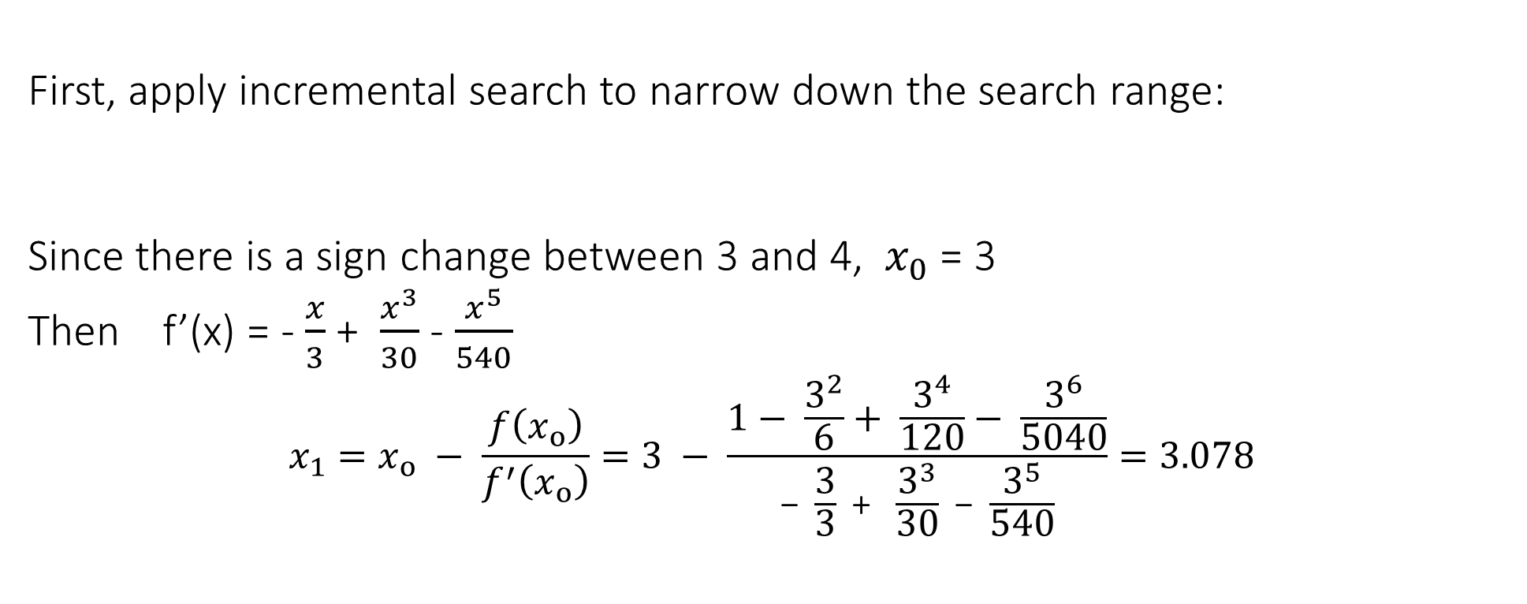
First, apply incremental search to narrow down the search range:
Since there is a sign change between 3 and 4, $x_{0}$= 3
Then f’(x) = - $\frac{x}{3}$ + $\frac{x^{3}}{30}$ - $\frac{x^{5}}{540}$
$$x_{1}=x_{o} − \frac{f\left(x_{o}\right)}{f^{′}\left(x_{o}\right)}=3 − \frac{1− \frac{3^{2}}{6}+ \frac{3^{4}}{120}− \frac{3^{6}}{5040}}{\text{− }\frac{3}{3}\text{ + }\frac{3^{3}}{30}\text{ − }\frac{3^{5}}{540}}=3.078$$
0 | 1 | 2 | 3 | 4
1 | 0.8415 | 0.4540 | 0.0304 | -0.3460
i | $$x_{i}$$ | f( $x_{i}$) | f1($x_{i+1}$) | $$x_{i+1}$$ | Abs error
0 | 3 | 0.030357 | -0.389286 | 3.077981 | 0.077
1 | 3.07781 | 2.53061x${10}^{−4}$ | -0.382860 | 3.08642 | 0.01
2 | 3.078642 | 1.165579x ${10}^{−7}$ | -0.382808 | 3.0786423 | 0.0000003
Root with an accuracy of 5 digits = 3.0786

Slide 22
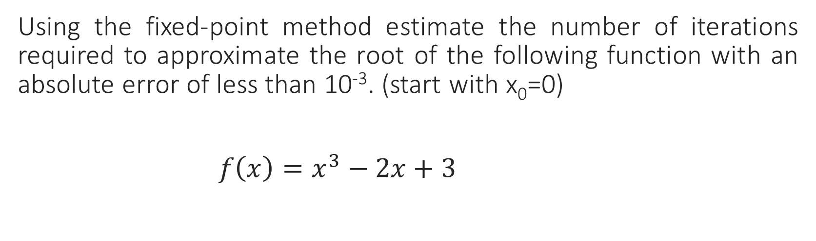
Order of Convergence
Using the fixed-point method estimate the number of iterations required to approximate the root of the following function with an absolute error of less than 10⁻³. (start with x₀=0)
$f\left(x\right)=x^{3}−2x+3$

Slide 23
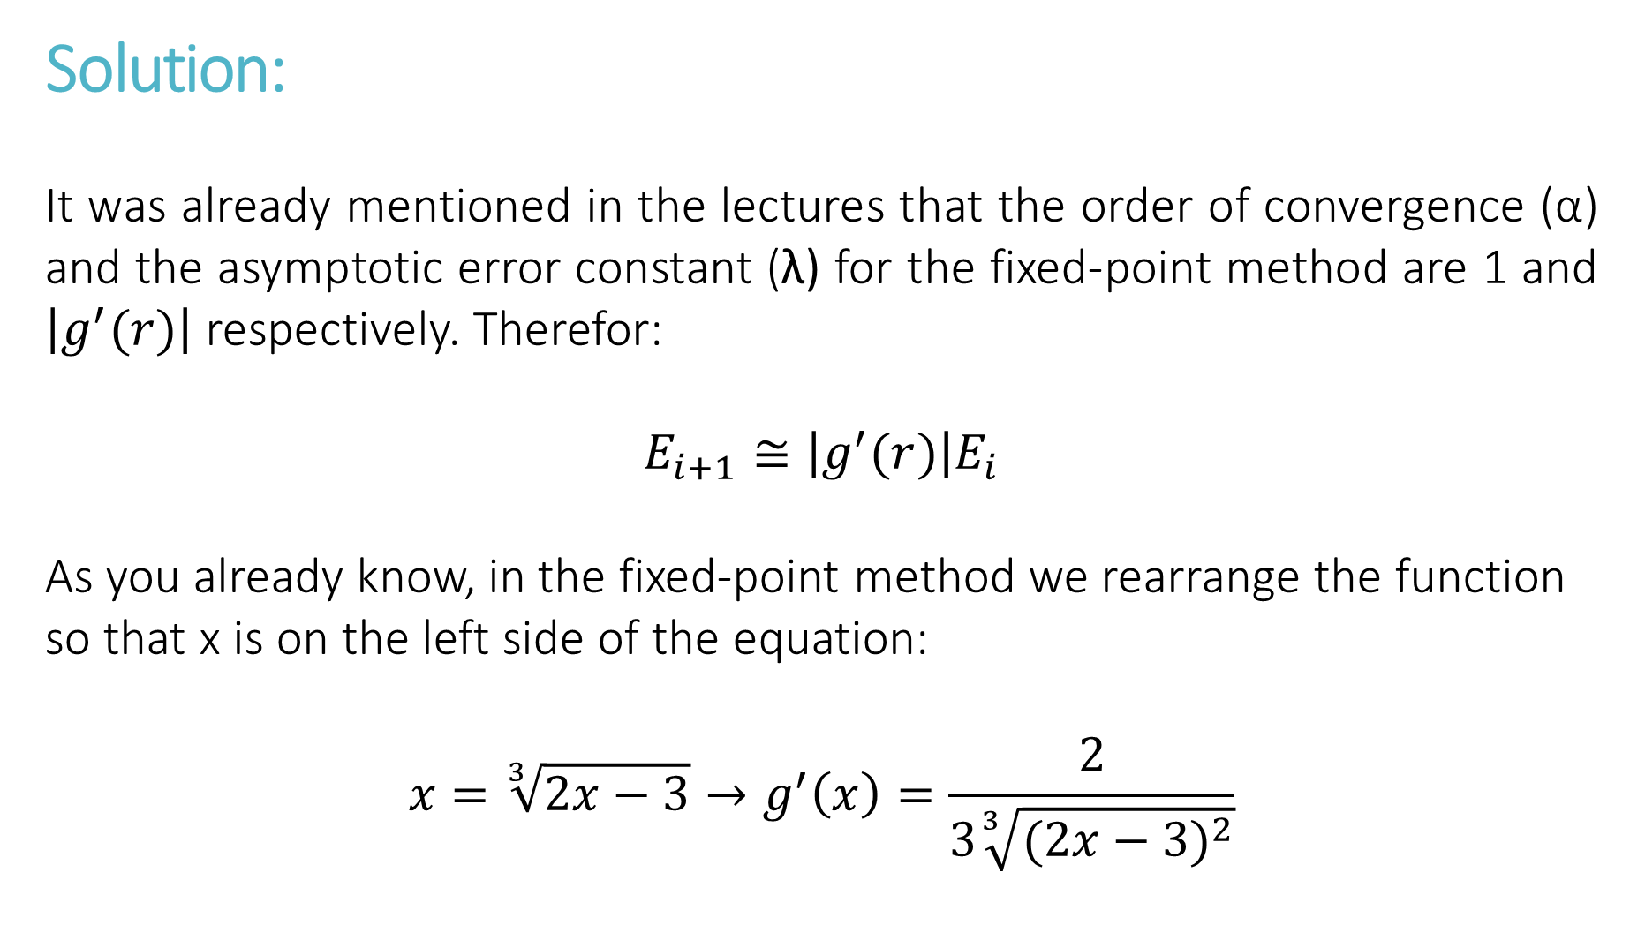
Solution:
It was already mentioned in the lectures that the order of convergence (α) and the asymptotic error constant (λ) for the fixed-point method are 1 and $\left|g^{′}(r)\right|$ respectively. Therefor:
$$E_{i+1}≅{\left|g^{′}(r)\right|E}_{i}$$
As you already know, in the fixed-point method we rearrange the function so that x is on the left side of the equation:
$$x=\sqrt[3]{2x−3}→g^{′}\left(x\right)=\frac{2}{3\sqrt[3]{{(2x−3)}^{2}}}$$

Slide 24
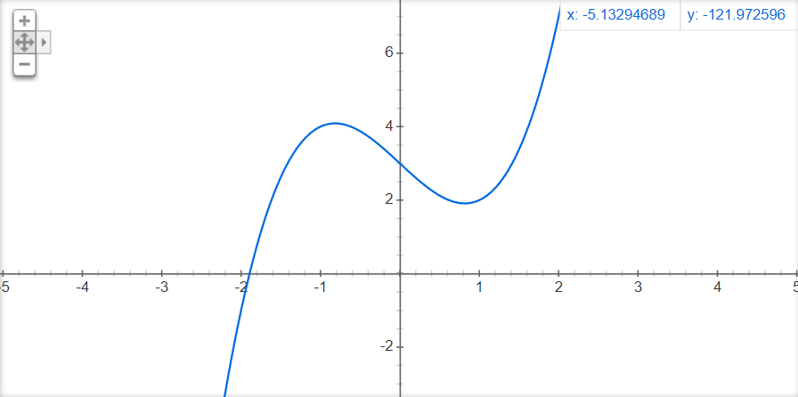
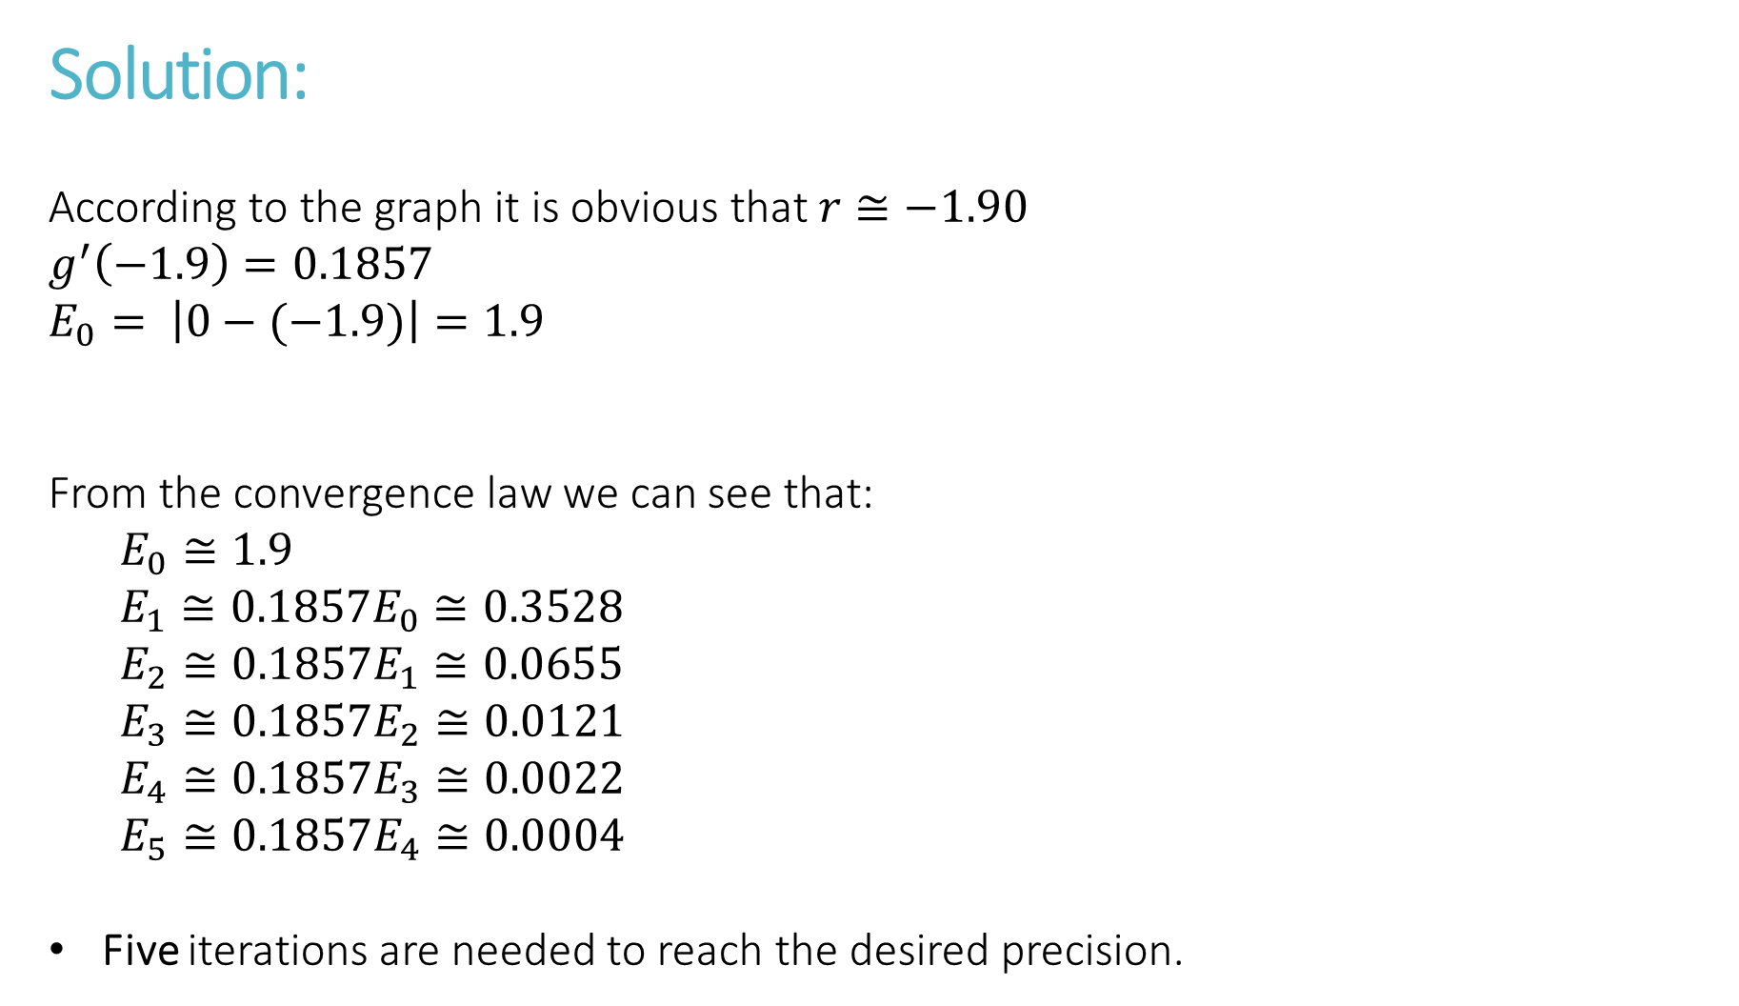
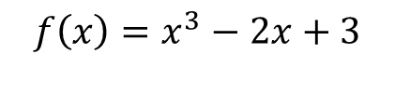

Solution:
According to the graph it is obvious that $r≅−1.90$
$$g^{′}\left(−1.9\right)=0.1857$$
$$E_{0}= \left|0−(−1.9)\right|=1.9$$
From the convergence law we can see that:
$$E_{0}≅1.9$$
$$E_{1}≅0.1857E_{0}≅0.3528$$
$$E_{2}≅0.1857E_{1}≅0.0655$$
$$E_{3}≅0.1857E_{2}≅0.0121$$
$$E_{4}≅0.1857E_{3}≅0.0022$$
$$E_{5}≅0.1857E_{4}≅0.0004$$
Five iterations are needed to reach the desired precision.
$$r≅−1.90$$
$$f\left(x\right)=x^{3}−2x+3$$

Slide 25
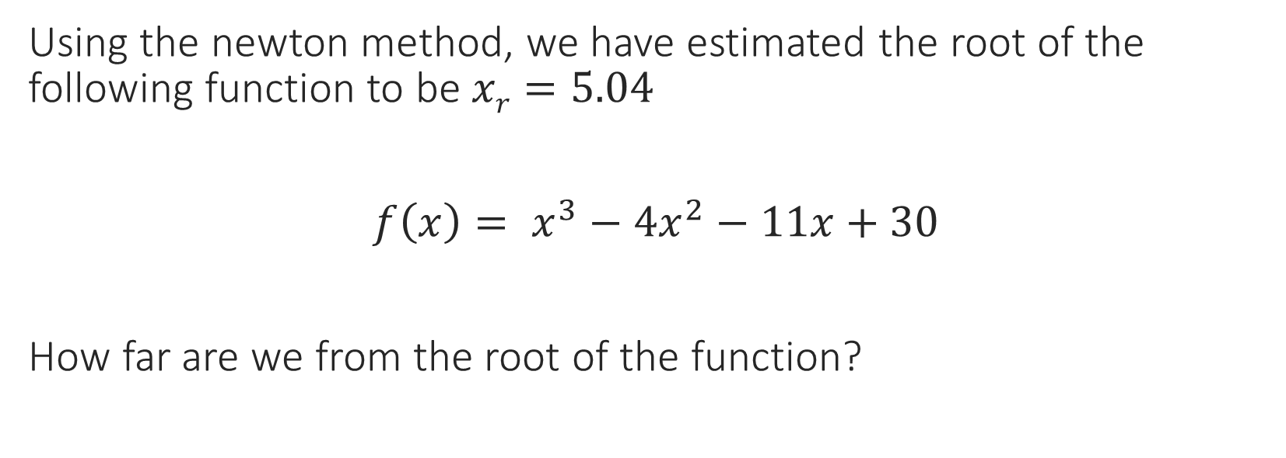
Forward and Backward Error
Using the newton method, we have estimated the root of the following function to be $xr=5.04$
$f\left(x\right)= x^{3}−{4x}^{2}−11x+30$
How far are we from the root of the function?

Slide 26
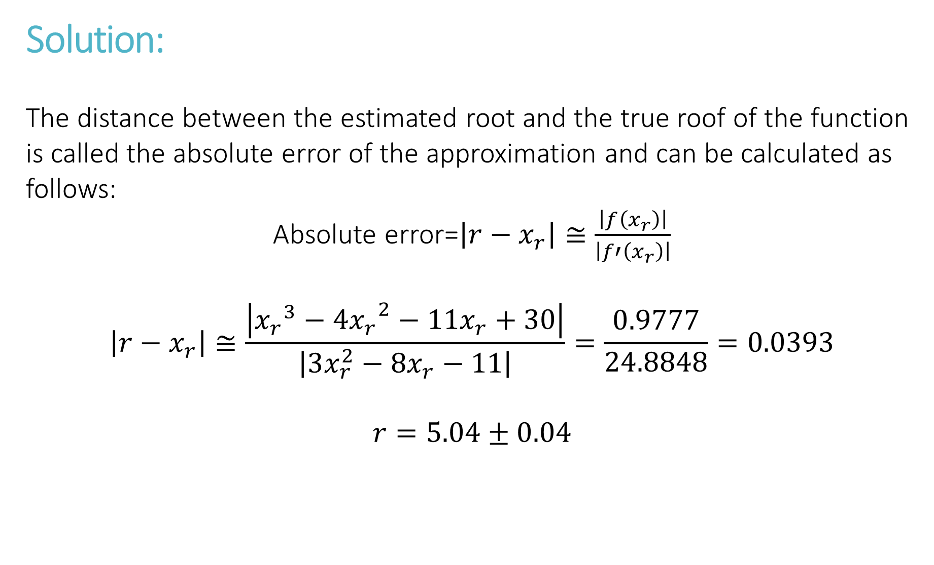
Solution:
The distance between the estimated root and the true roof of the function is called the absolute error of the approximation and can be calculated as follows:
Absolute error=$\left|r−x_{r}\right|≅\frac{\left|f\left(x_{r}\right)\right|}{\left|f′\left(x_{r}\right)\right|}$
$$\left|r−x_{r}\right|≅\frac{\left|{x_{r}}^{3}−{4x_{r}}^{2}−11x_{r}+30\right|}{\left|3x_{r}^{2}−8x_{r}−11\right|}=\frac{0.9777}{24.8848}=0.0393$$
$$r=5.04±0.04$$

Slide 27
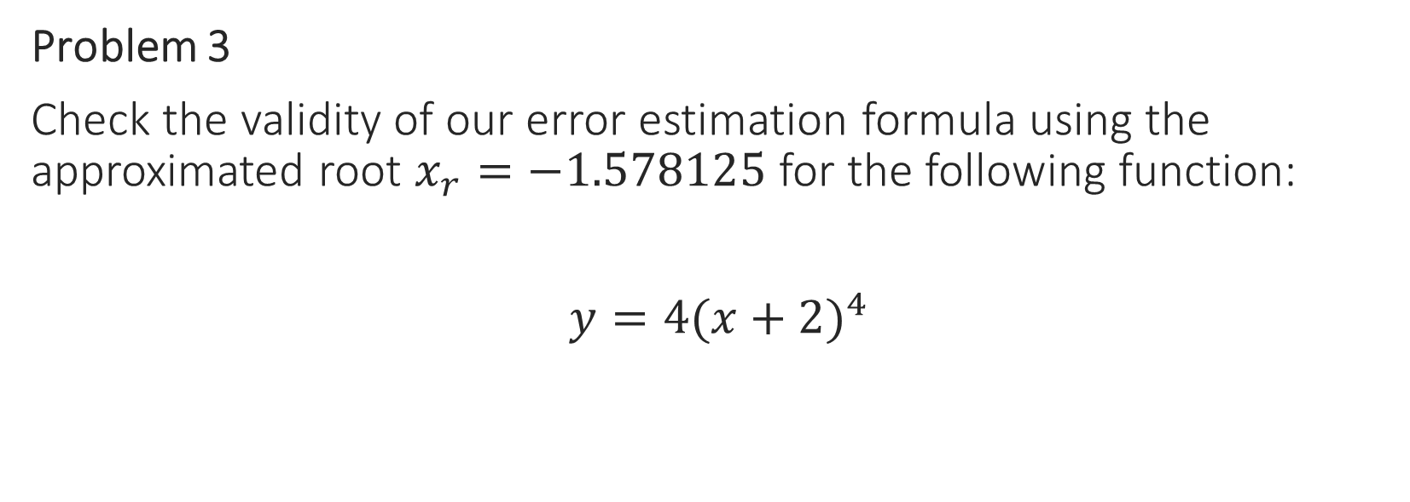
Root Multiplicity
Problem 3
Check the validity of our error estimation formula using the approximated root $x_{r}=−1.578125$ for the following function:
$y=4{(x+2)}^{4}$

Slide 28

Solution:
We already know that -2 is the root of the function and the true error is $\left|r−x_{r}\right|=0.4129$
We estimate the error using the following formula to see if it matches the true error:
$$\left|r−x_{r}\right|≅{\left|\frac{m!∙f(x_{r})}{f^{(m)}(x_{r})}\right|}^{1/m}$$

Slide 29
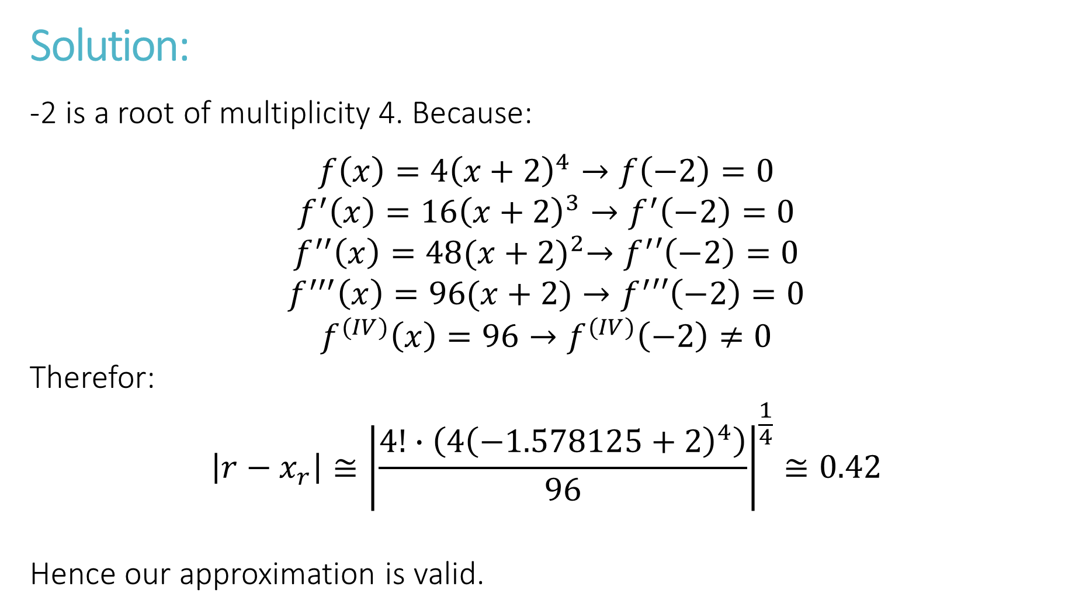
Solution:
-2 is a root of multiplicity 4. Because:
$$f\left(x\right)=4{\left(x+2\right)}^{4}→f\left(−2\right)=0$$
$$f^{′}\left(x\right)=16{\left(x+2\right)}^{3}→f^{′}\left(−2\right)=0$$
$$f^{′′}\left(x\right)=48{(x+2)}^{2}→f^{′}′\left(−2\right)=0$$
$$f^{′′′}\left(x\right)=96(x+2)→f^{′}′′\left(−2\right)=0$$
$$f^{(IV)}\left(x\right)=96→f^{(IV)}\left(−2\right)≠0$$
Therefor:
$$\left|r−x_{r}\right|≅{\left|\frac{4!∙\left(4{\left(−1.578125+2\right)}^{4}\right)}{96}\right|}^{\frac{1}{4}}≅0.42$$
Hence our approximation is valid.

